Slide 1

Carrier Sense Multiple Access (CSMA)
This method was developed to decrease the chances of collisions when two or more stations start sending their signals over the data link layer. Carrier Sense multiple access requires that each station first check the state of the medium before sending.

Slide 2
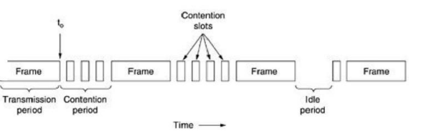
CSMA/CD (CSMA with Collision Detection)
If two stations sense the channel to be idle and begin transmitting simultaneously, they will both detect the collision almost immediately. Rather than finish transmitting their frames, which are irretrievably garbled anyway, they should abruptly stop transmitting as soon as the collision is detected.
Quickly terminating damaged frames saves time and bandwidth.
This protocol, known as CSMA/CD (CSMA with Collision Detection) is widely used on LANs in the MAC sub layer. In particular, it is the basis of the popular Ethernet LAN, so it is worth devoting some time to looking at it in detail.

Slide 3
CSMA/CA (carrier sense multiple access/collision Avoidance)
It is a protocol that works with a medium access control layer. When a data frame is sent to a channel, it receives an acknowledgment to check whether the channel is clear. If the station receives only a single (own) acknowledgments, that means the data frame has been successfully transmitted to the receiver.
But if it gets two signals, a collision of the frame occurs in the shared channel. Detects the collision of the frame when a sender receives an acknowledgment signal.

Slide 4
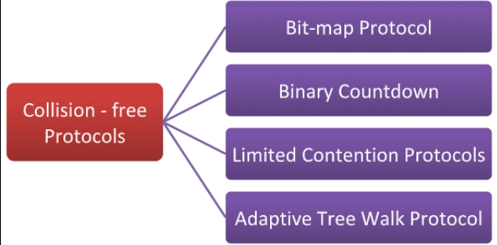
Collision-Free Protocols
Collision – free protocols are devised so that collisions do not occur. Protocols like CSMA/CD and CSMA/CA nullifies the possibility of collisions once the transmission channel is acquired by any station. However, collision can still occur during the contention period if more than one stations starts to transmit at the same time.

Slide 5
Bit – map Protocol
The contention period is divided into N slots, where N is the total number of stations sharing the channel. If a station has a frame to send, it sets the corresponding bit in the slot. So, before transmission, each station knows whether the other stations want to transmit. Collisions are avoided by mutual agreement among the contending stations on who gets the channel.

Slide 6
Binary Countdown
This protocol overcomes the overhead of 1 bit per station of the bit – map protocol. Here, binary addresses of equal lengths are assigned to each station. For example, if there are 6 stations, they may be assigned the binary addresses 001, 010, 011, 100, 101 and 110. All stations wanting to communicate broadcast their addresses. The station with higher address gets the higher priority for transmitting.

Slide 7
Limited Contention Protocols
These protocols combines the advantages of collision based protocols and collision free protocols. Under light load, they behave like ALOHA scheme. Under heavy load, they behave like bitmap protocols.

Slide 8
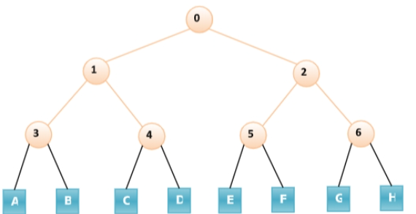
Adaptive Tree Walk Protocol
Initially all nodes (A, B ……. G, H) are permitted to compete for the channel. If a node is successful in acquiring the channel, it transmits its frame. In case of collision, the nodes are divided into two groups (A, B, C, D in one group and E, F, G, H in another group). Nodes belonging to only one of them is permitted for competing. This process continues until successful transmission occurs.

